Slide 1
IoT시스템
7주차 과제
반 YA 학번: 20202296
이름: 전채린

Slide 2
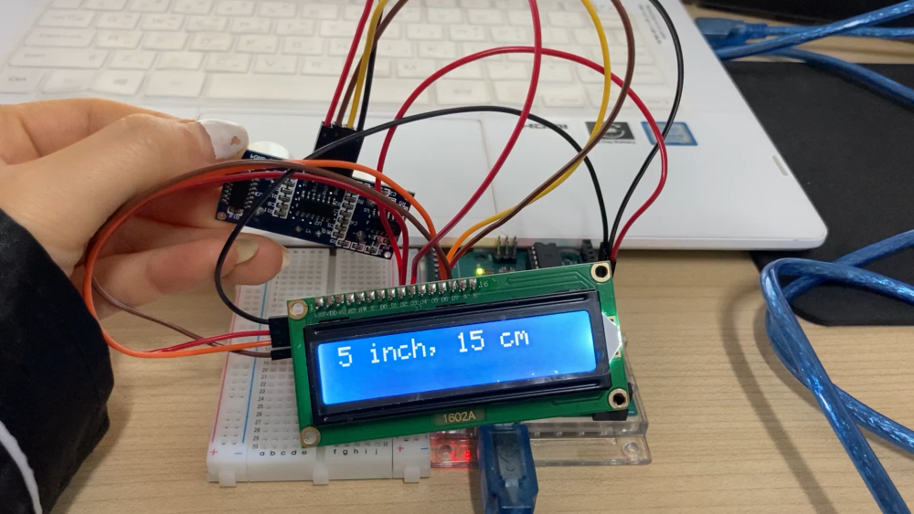
실습1 동영상이나 사진

Slide 3
실습1 스케치
#include <Wire.h>
#include <LiquidCrystal_I2C.h>
#define trigPin 13
#define echoPin 12
LiquidCrystal_I2C lcd(0x27, 16, 2);
void setup()
{
Serial.begin(9600);
pinMode(trigPin, OUTPUT);
pinMode(echoPin, INPUT);
lcd.begin();
lcd.backlight();
}
long microsecondsToInches(long microseconds)
{
// According to Parallax's datasheet for the PING))), there are
// 73.746 microseconds per inch
return microseconds / 74 / 2;
}

Slide 4
실습1 스케치
long microsecondsToCentimeters(long microseconds)
{
// The speed of sound is 340 m/s or 29 microseconds per centimeter.
// The ping travels out and back, so to find the distance of the
// object we take half of the distance travelled.
return microseconds / 29 / 2;
}
void loop()
{
long duration, inches, cm;
digitalWrite(trigPin, LOW);
delayMicroseconds(2);
digitalWrite(trigPin, HIGH);
delayMicroseconds(10);
digitalWrite(trigPin, LOW);
duration = pulseIn(echoPin, HIGH);

Slide 5
실습1 스케치
// convert the time into a distance
inches = microsecondsToInches(duration);
cm = microsecondsToCentimeters(duration);
lcd.clear();
Serial.print(inches);
Serial.print(" inch, ");
Serial.print(cm);
Serial.println(" cm");
lcd.print(inches);
lcd.print(" inch, ");
lcd.print(cm);
lcd.print(" cm");
delay(1000);
}

Slide 6
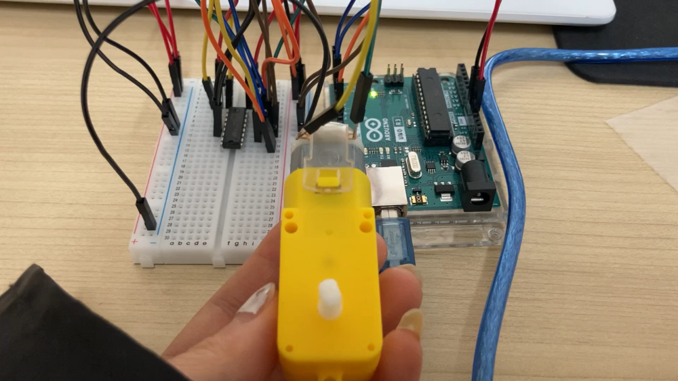
실습2 동영상

Slide 7
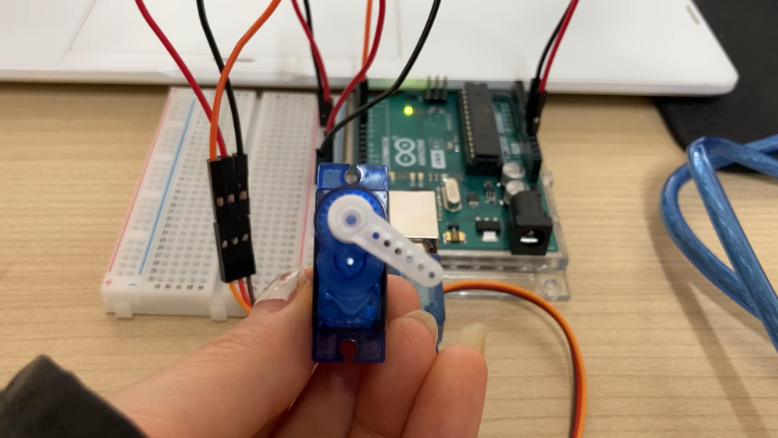
실습3 동영상

